Slide 1

© 2007 Thomson South-Western

Slide 2
Elasticity . . .
… allows us to analyze supply and demand with greater precision.
… is a measure of how much buyers and sellers respond to changes in market conditions

Slide 3
THE ELASTICITY OF DEMAND
The price elasticity of demand is a measure of how much the quantity demanded of a good responds to a change in the price of that good.
When we talk about elasticity, that responsiveness is always measured in percentage terms.
Specifically, the price elasticity of demand is the percentage change in quantity demanded due to a percentage change in the price.

Slide 4
The Price Elasticity of Demand and Its Determinants
Availability of Close Substitutes
Necessities versus Luxuries
Definition of the Market
Time Horizon

Slide 5
The Price Elasticity of Demand and Its Determinants
Demand tends to be more elastic:
  the larger the number of close substitutes.
  if the good is a luxury.
  the more narrowly defined the market.
  the longer the time period.

Slide 6
Computing the Price Elasticity of Demand
The price elasticity of demand is computed as the percentage change in the quantity demanded divided by the percentage change in price.

Slide 7
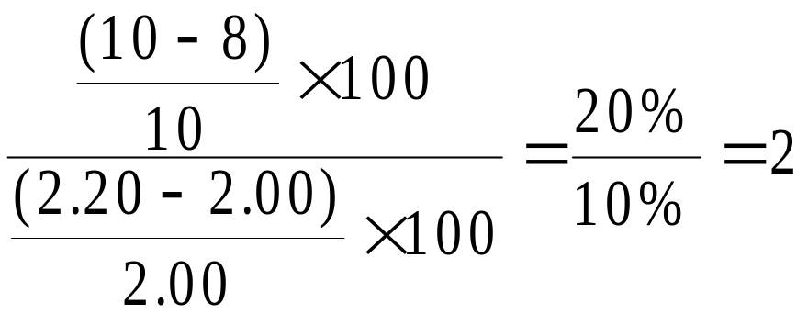
Computing the Price Elasticity of Demand
Example: If the price of an ice cream cone increases from $2.00 to $2.20 and the amount you buy falls from 10 to 8 cones, then your elasticity of demand would be calculated as:

Slide 8
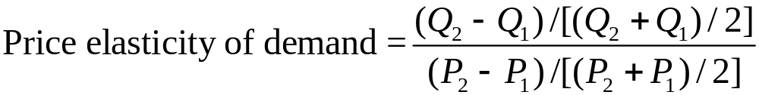
The Midpoint Method: A Better Way to Calculate Percentage Changes and Elasticities
The midpoint formula is preferable when calculating the price elasticity of demand because it gives the same answer regardless of the direction of the price change.

Slide 9
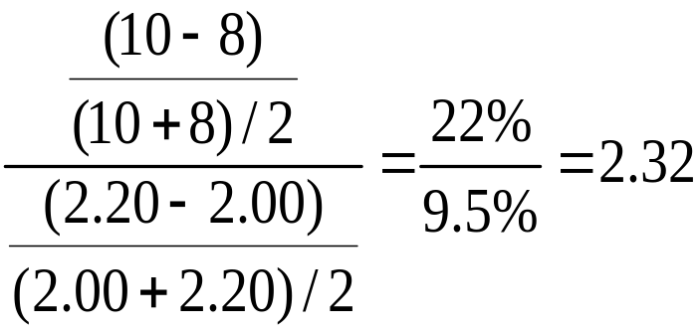
The Midpoint Method: A Better Way to Calculate Percentage Changes and Elasticities
Example: If the price of an ice cream cone increases from $2.00 to $2.20 and the amount you buy falls from 10 to 8 cones, then your elasticity of demand, using the midpoint formula, would be calculated as:

Slide 10
The Variety of Demand Curves
Inelastic Demand
  Quantity demanded does not respond strongly to price changes.
  Price elasticity of demand is less than one.
Elastic Demand
  Quantity demanded responds strongly to changes in price.
  Price elasticity of demand is greater than one.

Slide 11
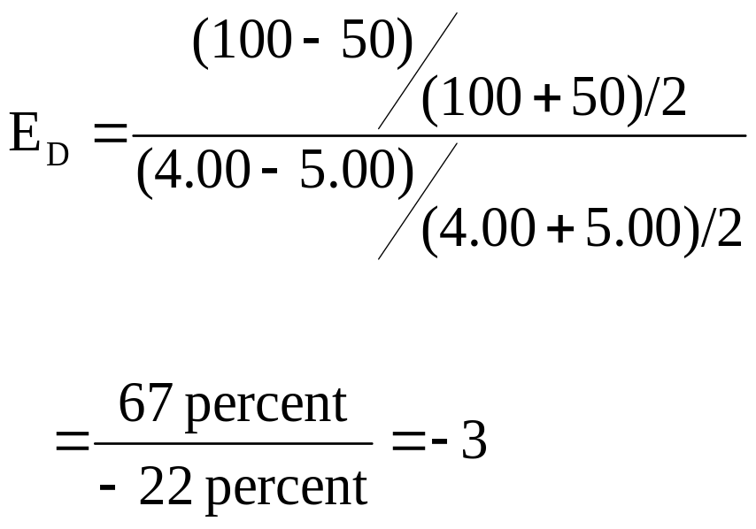
Computing the Price Elasticity of Demand
Price
$5
4
Demand
0
50
100
Quantity
Demand is price elastic.

Slide 12
The Variety of Demand Curves
Perfectly Inelastic
  Quantity demanded does not respond to price changes.
Perfectly Elastic
  Quantity demanded changes infinitely with any change in price.
Unit Elastic
  Quantity demanded changes by the same percentage as the price.

Slide 13
The Variety of Demand Curves
Because the price elasticity of demand measures how much quantity demanded responds to the price, it is closely related to the slope of the demand curve.
But it is not the same thing as the slope!

Slide 14
Figure 1 The Price Elasticity of Demand
(a) Perfectly Inelastic Demand: Elasticity Equals 0
Price
Demand
$5
4
1. An
increase
in price . . .
0
100
Quantity
2. . . . leaves the quantity demanded unchanged.

Slide 15
Figure 1 The Price Elasticity of Demand
(b) Inelastic Demand: Elasticity Is Less Than 1
Price
$5
4
1. A 22%
Demand
increase
in price . . .
0
90
100
Quantity
2. . . . leads to an 11% decrease in quantity demanded.

Slide 16
Figure 1 The Price Elasticity of Demand
(c) Unit Elastic Demand: Elasticity Equals 1
Price
$5
4
1. A 22%
Demand
increase
in price . . .
0
80
100
Quantity
2. . . . leads to a 22% decrease in quantity demanded.

Slide 17
Figure 1 The Price Elasticity of Demand
(d) Elastic Demand: Elasticity Is Greater Than 1
Price
$5
4
Demand
1. A 22%
increase
in price . . .
0
50
100
Quantity
2. . . . leads to a 67% decrease in quantity demanded.

Slide 18
Figure 1 The Price Elasticity of Demand
(e) Perfectly Elastic Demand: Elasticity Equals Infinity
Price
1. At any price
above $4, quantity
demanded is zero.
$4
Demand
2. At exactly $4,
consumers will
buy any quantity.
0
Quantity
3. At a price below $4,
quantity demanded is infinite.

Slide 19

Total Revenue and the Price Elasticity of Demand
Total revenue is the amount paid by buyers and received by sellers of a good.
Computed as the price of the good times the quantity sold.

Slide 20
Figure 2 Total Revenue
Price
When the price is $4, consumers will demand 100 units, and spend $400 on this good.
$4
P × Q = $400
P
(revenue)
Demand
0
100
Quantity
Q

Slide 21
Elasticity and Total Revenue along a Linear Demand Curve
With an inelastic demand curve, an increase in price leads to a decrease in quantity that is proportionately smaller. Thus, total revenue increases.

Slide 22
Figure 3 How Total Revenue Changes When Price Changes: Inelastic Demand
Price
Price
An Increase in price from $1
to $3 …
… leads to an Increase in total revenue from $100 to $240
$3
Revenue = $240
$1
Revenue = $100
Demand
Demand
0
100
Quantity
0
80
Quantity

Slide 23
Elasticity and Total Revenue along a Linear Demand Curve
With an elastic demand curve, an increase in the price leads to a decrease in quantity demanded that is proportionately larger. Thus, total revenue decreases.

Slide 24
Figure 3 How Total Revenue Changes When Price Changes: Elastic Demand
Price
Price
An Increase in price from $4
to $5 …
… leads to an decrease in total revenue from $200 to $100
$5
$4
Demand
Demand
Revenue = $200
Revenue = $100
0
50
Quantity
0
20
Quantity
Note that with each price increase, the Law of Demand still holds – an increase in price leads to a decrease in the quantity demanded. It is the change in TR that varies!

Slide 25
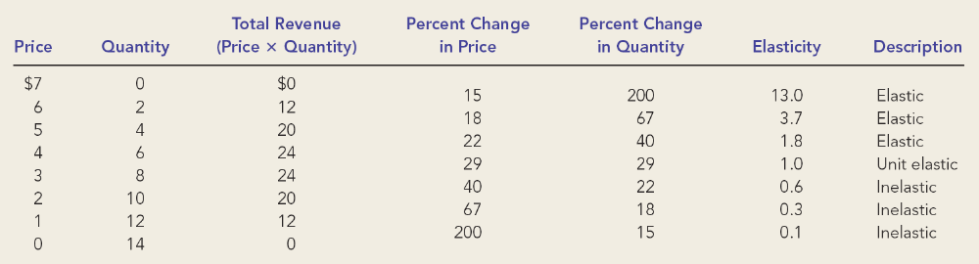
Elasticity of a Linear Demand Curve

Slide 26
Figure 4 Elasticity of a Linear Demand Curve
Demand is elastic; demand is responsive to changes in price.
When price increases from $4 to $5, TR declines from $24 to $20.
Price
$7
Elasticity is > 1 in this range.
6
5
4
Elasticity is < 1 in this range.
Demand is inelastic; demand is not very responsive to changes in price.
3
When price increases from $2 to $3, TR increases from $20 to $24.
2
1
0
2
4
6
8
10
12
14
Quantity

Slide 27
Other Demand Elasticities
Income Elasticity of Demand
  Income elasticity of demand measures how much the quantity demanded of a good responds to a change in consumers’ income.
  It is computed as the percentage change in the quantity demanded divided by the percentage change in income.

Slide 28
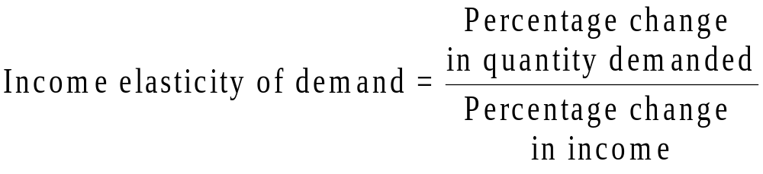
Other Demand Elasticities
Computing Income Elasticity
Remember, all elasticities are measured by dividing one percentage change by another

Slide 29
Other Demand Elasticities
Income Elasticity
  Types of Goods
    Normal Goods
    Inferior Goods
  Higher income raises the quantity demanded for normal goods but lowers the quantity demanded for inferior goods.

Slide 30
Other Demand Elasticities
Income Elasticity
  Goods consumers regard as necessities tend to be income inelastic
    Examples include food, fuel, clothing, utilities, and medical services.
  Goods consumers regard as luxuries tend to be income elastic.
    Examples include sports cars, furs, and expensive foods.

Slide 31
Other Demand Elasticities
Cross-price elasticity of demand
  A measure of how much the quantity demanded of one good responds to a change in the price of another good, computed as the percentage change in quantity demanded of the first good divided by the percentage change in the price of the second good

Slide 32
THE ELASTICITY OF SUPPLY
Price elasticity of supply is a measure of how much the quantity supplied of a good responds to a change in the price of that good.
Price elasticity of supply is the percentage change in quantity supplied resulting from a percentage change in price.

Slide 33
Figure 5 The Price Elasticity of Supply
(a) Perfectly Inelastic Supply: Elasticity Equals 0
Price
Supply
$5
4
1. An
increase
in price . . .
0
100
Quantity
2. . . . leaves the quantity supplied unchanged.

Slide 34
Figure 5 The Price Elasticity of Supply
(b) Inelastic Supply: Elasticity Is Less Than 1
Price
Supply
$5
4
1. A 22%
increase
in price . . .
0
100
110
Quantity
2. . . . leads to a 10% increase in quantity supplied.

Slide 35
Figure 5 The Price Elasticity of Supply
(c) Unit Elastic Supply: Elasticity Equals 1
Price
Supply
$5
4
(If SUPPLY is unit elastic and linear, it will begin at the origin.)
1. A 22%
increase
in price . . .
0
100
125
Quantity
2. . . . leads to a 22% increase in quantity supplied.

Slide 36
Figure 5 The Price Elasticity of Supply
(d) Elastic Supply: Elasticity Is Greater Than 1
Price
Supply
$5
4
1. A 22%
increase
in price . . .
0
100
200
Quantity
2. . . . leads to a 67% increase in quantity supplied.

Slide 37
Figure 5 The Price Elasticity of Supply
(e) Perfectly Elastic Supply: Elasticity Equals Infinity
Price
1. At any price
above $4, quantity
supplied is infinite.
$4
Supply
2. At exactly $4,
producers will
supply any quantity.
0
Quantity
3. At a price below $4,
quantity supplied is zero.

Slide 38
The Price Elasticity of Supply and Its Determinants
Ability of sellers to change the amount of the good they produce.
  Beach-front land is inelastic.
  Books, cars, or manufactured goods are elastic.
Time period
  Supply is more elastic in the long run.

Slide 39
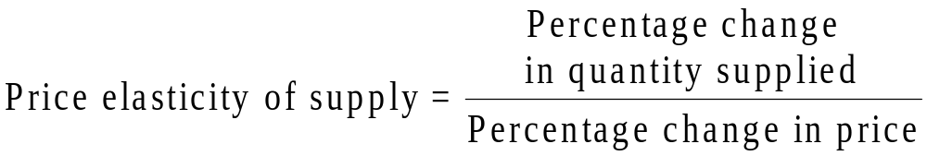
Computing the Price Elasticity of Supply
The price elasticity of supply is computed as the percentage change in the quantity supplied divided by the percentage change in price.

Slide 40
THREE APPLICATIONS OF SUPPLY, DEMAND, AND ELASTICITY
Can good news for farming be bad news for farmers?
What happens to wheat farmers and the market for wheat when university agronomists discover a new wheat hybrid that is more productive than existing varieties?

Slide 41
Can Good News for Farming Be Bad News for Farmers?
Examine whether the supply or demand curve shifts.
Determine the direction of the shift of the curve.
Use the supply-and-demand diagram to see how the market equilibrium changes.

Slide 42
Figure 7 An Increase in Supply in the Market for Wheat
Price of
Wheat
1. When demand is inelastic,
2. . . . leads
an increase in supply
. . .
to a large fall
S₁
in price . . .
S₂
$3
2
Demand
0
100
110
Quantity of
Wheat
3. . . . and a proportionately smaller
increase in quantity sold. As a result,
revenue falls from $300 to $220.

Slide 43
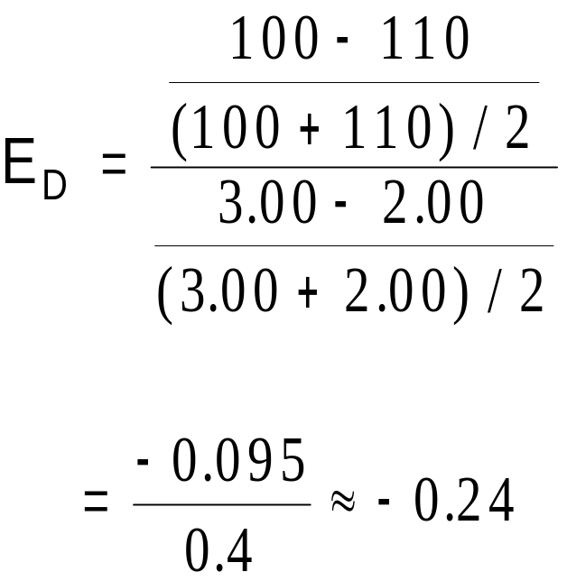
Compute the Price Elasticity of Demand When There Is a Change in Supply
Demand is inelastic.

Slide 44
Why Did OPEC Fail to Keep the Price of Oil High?
Supply and Demand can behave differently in the short run and the long run
  In the short run, both supply and demand for oil are relatively inelastic
  But in the long run, both are elastic
    Production outside of OPEC
    More conservation by consumers

Slide 45
Does Drug Interdiction Increase or Decrease Drug-Related Crime?
Drug interdiction impacts sellers rather than buyers.
  Demand is unchanged.
  Equilibrium price rises although quantity falls.
Drug education impacts the buyers rather than sellers.
  Demand is shifted.
  Equilibrium price and quantity are lowered.

Slide 46
Figure 9 Policies to Reduce the Use of Illegal Drugs
Drug Interdiction
Drug Education
Price of Drugs
Price of Drugs
S₂
S₁
S₁
It is amazing how useful knowledge of elasticities can be!
D₁
D₁
D₂
Quantity of Drugs
Quantity of Drugs
In each case, the change in price is the same.
But in one market the price goes up.
The demand for illegal drugs is inelastic.
Interdiction shifts the supply,
while education shifts the demand.
The changes in quantities (and TR) are remarkable.
And in the other it goes down.

Slide 47
Price elasticity of demand measures how much the quantity demanded responds to changes in the price.
Price elasticity of demand is calculated as the percentage change in quantity demanded divided by the percentage change in price.
  If a demand curve is elastic, total revenue falls when the price rises.
  If it is inelastic, total revenue rises as the price rises.

Slide 48
The income elasticity of demand measures how much the quantity demanded responds to changes in consumers’ income.
The cross-price elasticity of demand measures how much the quantity demanded of one good responds to the price of another good.
The price elasticity of supply measures how much the quantity supplied responds to changes in the price.

Slide 49
In most markets, supply is more elastic in the long run than in the short run.
The price elasticity of supply is calculated as the percentage change in quantity supplied divided by the percentage change in price.
The tools of supply and demand can be applied in many different types of markets.

